Slide 1
COMPILER CONSTRUCTION CS F363
Preliminaries
Role of Symbol Table
Implementation
Symbol Table
R. Elakkiya, AP/CS

Slide 2
Symbol Table (ST)
Symbol tables are data structures that are used by compilers to hold information about source-program constructs
The information is collected incrementally by the analysis phases of a compiler and used by the synthesis phases to generate the target code
Entries in the symbol table contain information about an identifier such as its character string (or lexeme), its type, its position in storage, and any other relevant information
Problem: a) Handling ST for block structured PL. b) STs typically need to support multiple declarations of the same identifier at different blocks within a program.

Slide 3
Block Structured Languages
Basic building units are blocks.
There can be nested blocks upto any depth.

Slide 4
Block Structured Languages
Basic building units are blocks.
There can be nested blocks upto any depth.

Slide 5
Example
01:float x=10,y=5,z=30; 02:int main()
03:{
04: float y=40;
05: if(1){
06: float x=50;
07: }
08: if(y<z){
09: printf("z=%f",z);
10: }
11: else{
12: if(y<x){
13: printf("z=%f",z);
14: }
15: else{
16: printf("x=%f",x);
17: }
18: }
19:}

Slide 6
Example
01:float x=10,y=5,z=30; 02:int main()
03:{
04: float y=40;
05: if(1){
06: float x=50;
07: }
08: if(y<z){//y=40,z=30
09: printf("z=%f",z);
10: }
11: else{
12: if(y<x){
13: printf("z=%f",z);
14: }
15: else{
16: printf("x=%f",x);
17: }
18: }
19:}

Slide 7
01:float x=10,y=5,z=30; 02:int main()
03:{
04: float y=40;
05: if(1){
06: float x=50;
07: }
08: if(y<z){//y=40,z=30
09: printf("z=%f",z);
10: }
11: else{
12: if(y<x){//y=40,x=10
13: printf("z=%f",z);
14: }
15: else{
16: printf("x=%f",x);
17: }
18: }
19:}

Slide 8
Scope of Identifier
Definition
Scope of identifier x : refers to a portion of a program that the identifier is visible.
Same identifier can be declared and used for different purpose in different parts of the program.
Same method names can appear in subclasses to override a method in super class.
**Scope of an identifier is from the recent opening brace (’{’) it has seen, until the corresponding matching closing brace (’}’).

Slide 9
Scope of Identifier
Definition
Scope of identifier x : refers to a portion of a program that the identifier is visible.
Same identifier can be declared and used for different purpose in different parts of the program.
Same method names can appear in subclasses to override a method in super class.
**Scope of an identifier is from the recent opening brace (’{’) it has seen, until the corresponding matching closing brace (’}’).

Slide 10
Scope of Identifier
Definition
Scope of identifier x : refers to a portion of a program that the identifier is visible.
Same identifier can be declared and used for different purpose in different parts of the program.
Same method names can appear in subclasses to override a method in super class.
**Scope of an identifier is from the recent opening brace (’{’) it has seen, until the corresponding matching closing brace (’}’).

Slide 11
Scope of Identifier
Definition
Scope of identifier x : refers to a portion of a program that the identifier is visible.
Same identifier can be declared and used for different purpose in different parts of the program.
Same method names can appear in subclasses to override a method in super class.
**Scope of an identifier is from the recent opening brace (’{’) it has seen, until the corresponding matching closing brace (’}’).

Slide 12
Most-closely nested rule for blocks
Enables to find the scope of an identifier
It states that an identifier x is in the scope of the most-closely nested declaration of x; that is, the declaration of x found by examining blocks inside-out, starting with the block in which x appears

Slide 13
How to implement scopes for block structured languages?
Set up a separate symbol table for each scope
Chain a ST of a block with the symbol table of its enclosing block (if it has one)
This would result in chained symbol table

Slide 14
Scope Example
**Subscripts are just for the sake of distinguishing //Occurrence of
w , possibly within the scope of w outside this segment of code.
{
int x; int y;
{
int w; bool y; int z;
w ; x; y; z;
}
w ; x; y;
}
top
w | int
y | bool
z | int
top
x | int
y | int
top
int
int
bool
int
char
int
int
top
w | char
top

Slide 15
Solve (WAP) for the following task
Input:
{ int x; char y; { bool y; x; y; } x; y; }
Output:
{ { x:int; y:bool; } x:int; y:char; }
Input
Output
prog
Use lex -> can we write a lex program ??
No
Use yac -> can we write a yacc program ??
Yes

Slide 16
Example Input/Output
**Subscripts are just for the sake of distinguishing //Occurrence of
w , possibly within the scope of w outside this segment of code.
{
int x; char y;
{
bool y;
x; y;
}
x; y;
}
top
y | bool
top
x | int
y | char
top
int
bool
int
char
top
null
top

Slide 17
Design
Whenever an ’{’ is being processed,
i) N = new Symbol Table Node // create a new Node
ii) N -> prev = top // link the new Node to the current node (top)
iii) top = N //set top to New Node
{
{
top
top
top
null
Symbol Tables in Block Structured languages

Slide 18
Design
Whenever an ’}’ is being processed,
i) save = top -> next // save the parent node
ii) delete top //delete the current top
iii) top = save //set top to parent node.
{
{
}
}
top
save
top
save
top
null

Slide 19
Design
For each newly declared variable, add it to the Current Symbol Table Node pointed by top.
x | char
z | int
top
{
int x; int y;
{
char x; int z;
top
x | int
y | int
top
null

Slide 20
Design
Whenever a variable is used (say x = y + z ;)
i) found = searchSym(top) // check in the current level.
ii) If not, move to the parent node of top and repeat the same.
**Note that every parent node in table tree corresponds to a block which is active (have seen ’{’, but yet to see matching closing ’}’)
{
int x; int y;
{
char x; int z;
z; x; y;
}
x; y;
}
top
x | char
z | int
x | int
y | int
null

Slide 21
Implementation
package symbols; import java.util.*; public class Env {
private Hashtable table; protected Env prev;
public Env(Env p) {
table = new Hashtable(); prev = p;
}
public void put(String s, Symbol sym) { table.put(s, sym);
}

Slide 22
Implementation
public Symbol get(String s) {
for( Env e = this; e != null; e = e.prev ) { Symbol found = (Symbol)(e.table.get(s)); if( found != null ) return found;
}
return null;
}
}
{ int x; char y; { bool y; x; y; } x; y; }
{ { x:int; y:bool; } x:int; y:char; }

Slide 23
The Parse
program →
block
block → ‘{‘
decls stmts ‘}’
decls → decls decl
| ɛ
decl → type id ‘;’
stms → stmts stmt
| ɛ
stmt → block
| factor ‘;’
factor → id
{ top = null; }
{ saved = top; top = new Env(top); printf("{");}
{ top = saved; printf("} ");}
{ s = new Symbol(id.lexeme, type.lexeme);
top.put(id.lexeme, s);}
{print( "; ") ; }
{ s = top.get(id.lexeme);
print(id.lexeme, ":", s.type); }

Slide 24
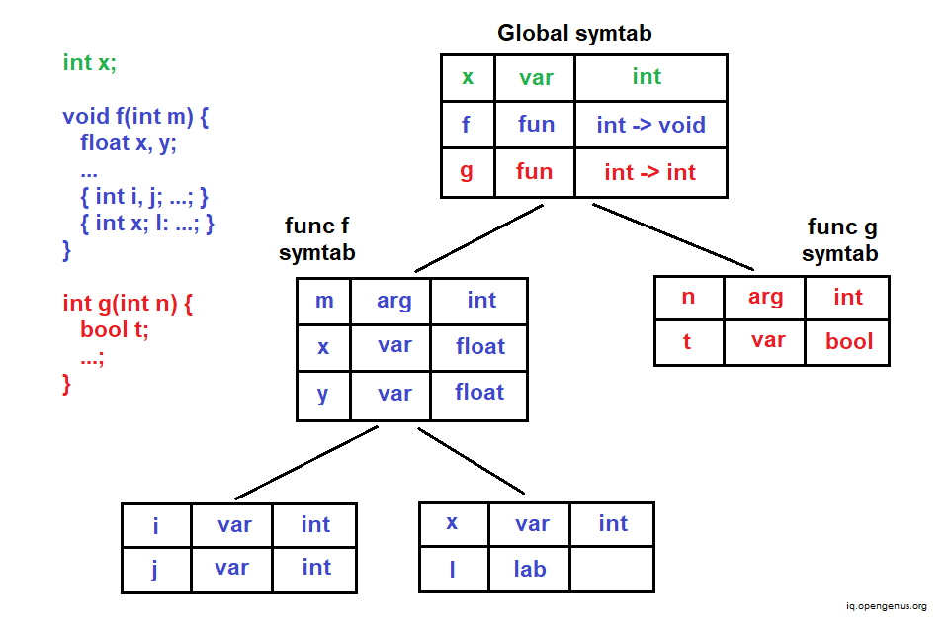
Tutorial 1
Consider the following code and construct the symbol table for the same with proper hierarchy

Slide 25
Solution

Slide 26
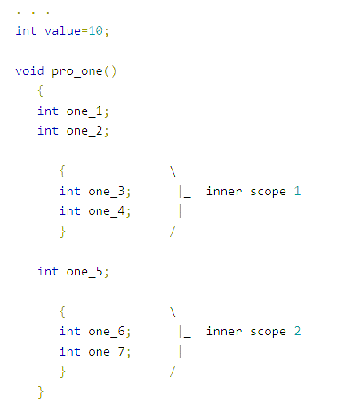
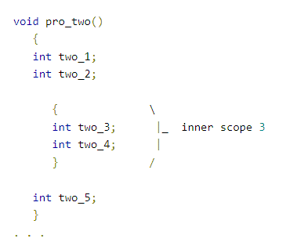
Tutorial 2

Slide 27
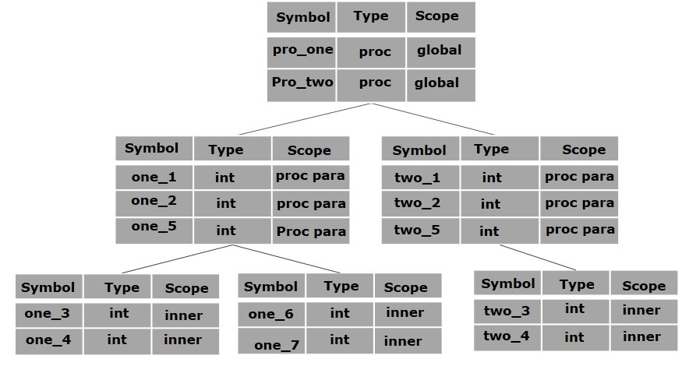
Solution 2

Slide 28
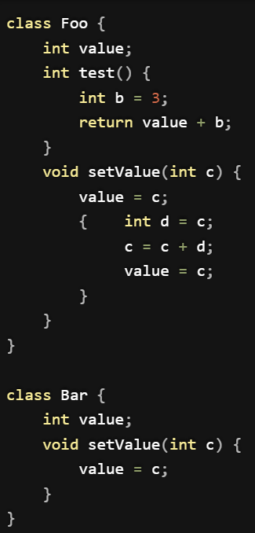
Tutorial 3

Slide 29
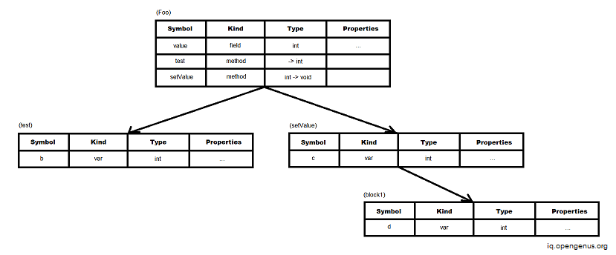
Solution 3

